Slide 1
Strategic Planning Infographics
01
02
03
04
Analysis
Strategy
Execution
Tracing
Mercury is the closest planet to the Sun
Venus is the second planet from the Sun
Jupiter is the biggest planet of them all
It is a ringed planet and a gas giant

Slide 2
Flood Finder Timeline
 | December 2020 | January 2021 | February 2021 | March 2021 | April 2021 | May 2021
Collect and Prepare Data
Prototype Dashboard
Build AI Algorithm
Prototype Notification
White paper

Slide 3
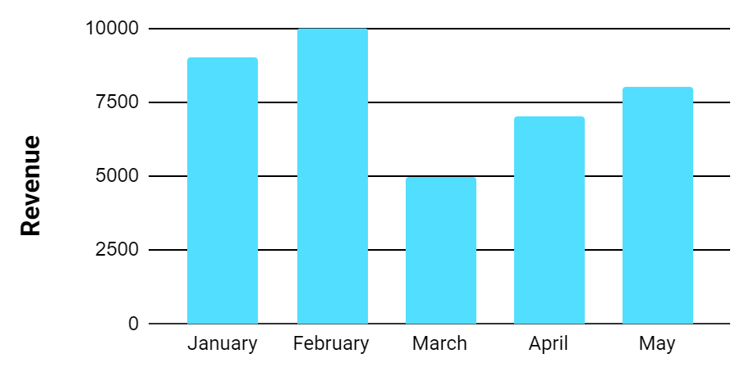
Strategic Planning Infographics
Planning
Execution
Mercury is the closest planet to the Sun
Neptune is the farthest planet from the Sun
Development
Tracing
Despite being red, Mars is a cold place
It's the biggest planet in the Solar System
Venus has a beautiful name. It’s hot
Saturn is the ringed planet. It’s a gas giant
The Sun is the star at the center
The Moon is a satellite. It orbits Earth

Slide 4
Strategic Planning Infographics
Tactics
Execution
Venus is the second planet from the Sun
It is the ringed planet and a gas giant
01
03
02
04
Analysis
Planning
Mercury is the closest planet to the Sun
Jupiter is the biggest planet of them all

